Slide 1
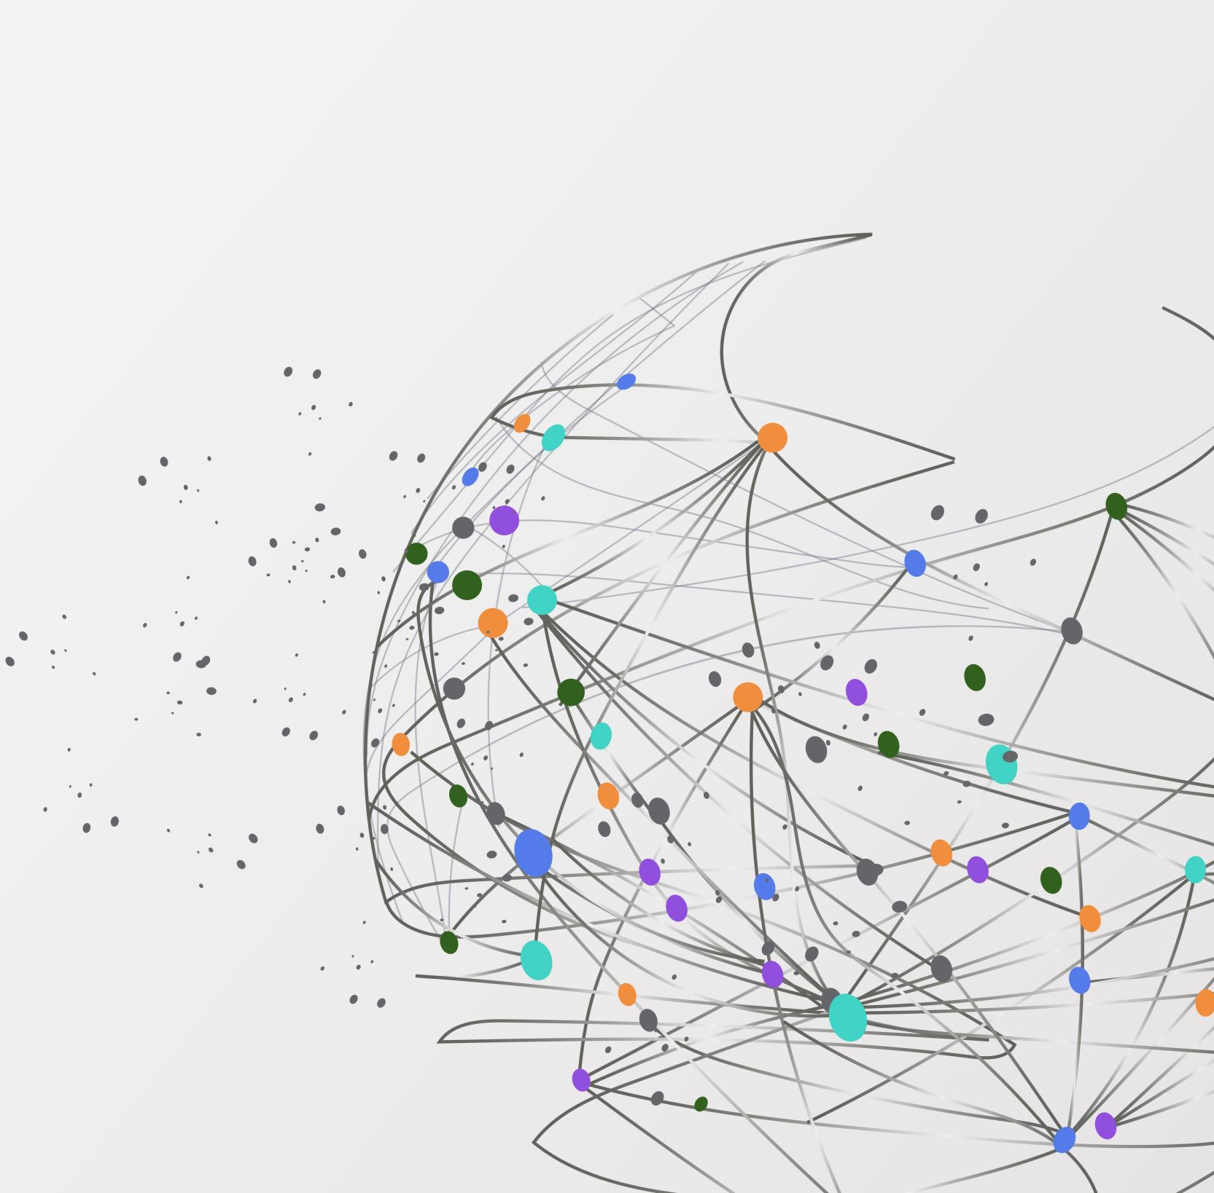
First American Financial Data Leak
By Jared Andraszek
Notes:
Hello. My name is Jared Andraszek and today I will be covering the First American Financial Data Leak from 2019.

Slide 2
Overview
Background prior to the leak
What happened
Who did it
How it could have been prevented
Notes:
In this presentation I will go over the Background and necessary information prior to the leak, What happened, Who did it, and How it could have been prevented.

Slide 3
Prior to the data leak
What is First American?
A title insurance and settlement service provider for primarily the real estate industry
Why was their data important?
They were in possession of millions of documents that had personal information such as SSNs, bank account numbers, driver’s licenses etc.
Notes:
So, who are First American?
- First American is a title insurance and settlement service provider for primarily the real estate industry. A title is a legal right to ownership and can extend to not only a home but also a car or boat. And they would cover any legal issues with that title, such as multiple claims and improper paperwork, for a subscription fee.
Well then, why was their data important? Well, they were in possession of millions of documents that had personal information such as Social Security Numbers, Bank Account numbers, Driver’s licenses etc.
And this information is meant to be kept private. So, if someone was to get ahold of your data, you could be subject to accurate phishing scams and impersonation.

Slide 4
What Happened?
There was an authentication error
If you had the web URL to a PDF page, you could have immediate access to that PDF.
Insecure Direct Object Reference (IDOR) Examples
https://website.com/info_variable?info_value=11111
https://website.com/filename.pdf
Notes:
So, what caused this?
Well, there was an authentication error where if you had the web URL to a PDF web page, you could have immediate access to that PDF.
Or what is called an Insecure Direct Object Reference (IDOR). Some examples of an IDOR would be similar to an SQL injection where you are inserting the necessary information into the URL and pushing it into the server. And then get the document linked to that information. Another example could have the filename in the URL and changing a few points or numbers to get a different file.

Slide 5
Who did it?
EVERYONE!!!
Because it was no authentication many were able to get access to years' worth of personal information and financial statements
Notes:
So, who did it?
Everyone!!! Because there was no authentication, many were able to get access to year’s worth of personal information and financial statements and documents. At the time of discovery First American had over 855 Million documents that could have been viewed. And with some brute force bots, people could get access to those documents. These documents went back to 2003 and could see documents before they were made public. There was no announcement on the number of documents that were viewed through this method though.
However, normal real estate agents and users of First American were accessing their documents without any authorization and thus, also utilizing this breach.

Slide 6

How could it have been prevented?
Enforce more secure authentication
Multi-layer authentication
Require passwords to view documents
Notes:
Well then how could this have been prevented?
- To start, there need to be a more secure method to authenticate the viewers. This could be done by requiring someone to login to another website or platform to then read their documents. They should have forced downloading the document and make that document password protected. Then give that password or passkey to the user in their account. That way it wouldn’t have been accessible to everyone.

Slide 7
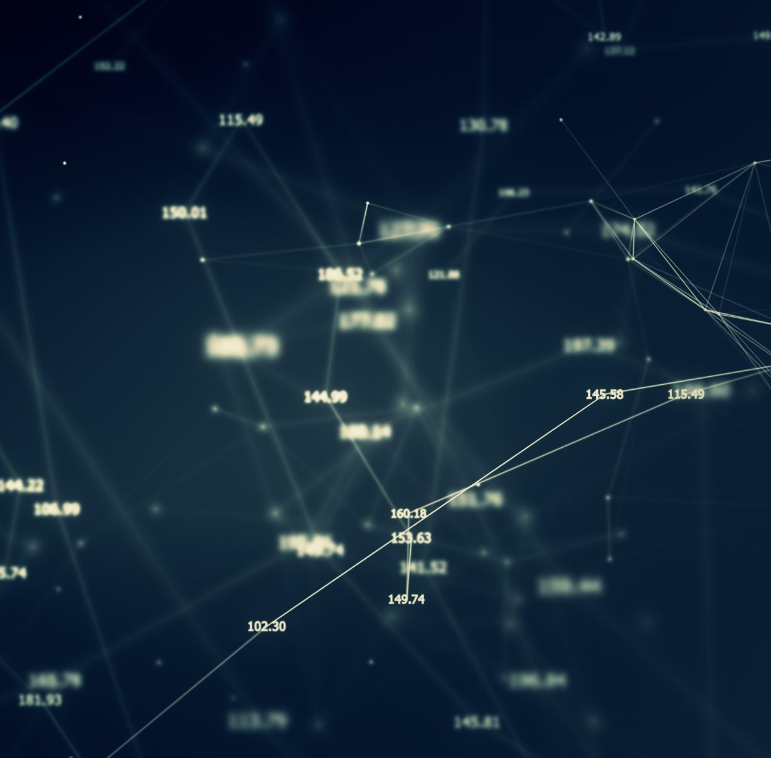
Summary
Background prior to the attack
What happened
Who did it
How it could have been prevented
Notes:
In summary I covered
the company’s background and necessary information prior to the attack
What happened during the attack and what an Insecure Direct Object Reference was
How everyone who utilized the service, either intentionally or unintendedly, broke in and got their files
And how incorporating passwords and improved Authentication protocols could have prevented the leak

Slide 8
Sources
https://krebsonsecurity.com/2019/05/first-american-financial-corp-leaked-hundreds-of-millions-of-title-insurance-records/
https://www.firstam.com/title-insurance-and-settlement-services/index.html
https://portswigger.net/web-security/access-control/idor
Notes:
These are the sources that I used.

Slide 9

Thank You
Notes:
And thank you for watching.

